Slide 1

System Design & Analysis
PHASE ONE
2.7.2004

Slide 2

Meet the team
PROJECT MANAGER
Adria Gratiot
PROGRAMMER
Matt Neiner
PROGRAMMER
Timothy Huffman
PROGRAMMER
Carl Samuels

Slide 3
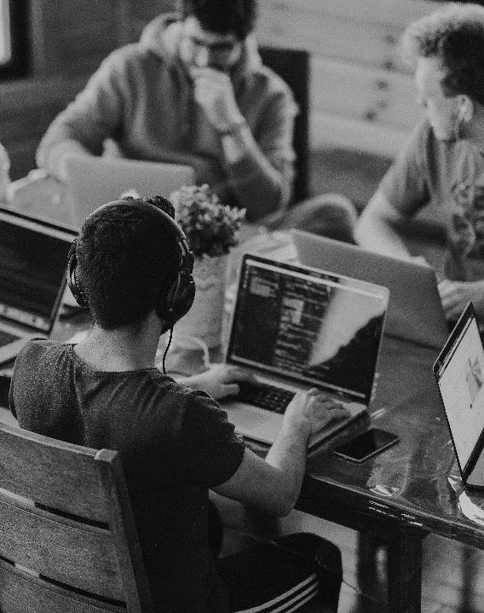
INTRODUCTION Project idea
PET NAMER
Would you like help picking a name for your pet?
Simply upload a picture and we’ll recommend a few different names for you!

Slide 4

Executive summary
Project proposal
After a client uploads a picture of their pet, our image recognition will be able to determine what kind of animal it is, then recommend names based off this information and a couple of other factors such as the animal’s coloring.

Slide 5
Components statement of work
Landing page with account creation
Picture upload screen
Picture recognition response
Name suggestions from designated databases based on the animal and obvious features
Ability to save favorite names to account database

Slide 6

Frontend technology
VSCode IDE
Vue
HTML
CSS
JavaScript

Slide 7
backend technology
VSCode IDE
Python 3.11.8
Django
PostgreSQL

Slide 8

Cutting edge APIs
CURRENTLY RESEARCHING
We need an API for animal photo recognition, here’s what we are looking at possibly implementing:
Amazon Rekognition
Imagga
The Dog API
Vision AI
KerasCV

Slide 9
Timeline & milestones
Phase 1 | Phase 2 | Phase 3 | Phase 4
February 7 | March 6 | April 10 | May 1
PROJECT SELECTED | FRONTEND DEVELOPMENT | BACKEND DEVELOPMENT | TESTING & ADJUSTMENT

Slide 10
THANK YOU
Team 1: Phase One

